Slide 1
MAJOR PROJECT
Title :-
CUSTOMER SATISFACTION FOR RESTAURANTS BASED ON THE PARAMETERS FOR THE BUSSINESS DEVELOPMENT

Slide 2
Abstract
Our system is mainly focusing on the implementation of web application through which user can able to extract their required information of the restaurants by providing some queries to filter the data from the different social networking sites currently available in the market. We will be using decision tree and neural networking technologies to achieve our required built of the system. It will help in getting the best restaurants among all within a city in a moment of a click.

Slide 3
Literature Survey
Title | Author | Published Date | Algorithm
Evaluation Of Customer Satisfaction Using the Quality Function Deployment | Marcela Pavlickuva | 2015 | ANOVA analysis and Customer Windows
Data Mining for Predicting Customer Satisfaction in Fast Food Restaurant | Bayu Adhi Tama | 2015 | Neural Network and Decision Tree
Evaluation of Service Quality based On Customer Satisfaction | Jing Hua Shi Qiang Su | 2007 | Customer Satisfaction Degree (CSD) and Service Quality Evaluation
Objective: Service quality plays an important role while determining customer satisfaction. Apart from it ,its environment,safety and ambience also are some reasonable factors for customer satisfaction which we can derive by using decision tree and neural network techniques.

Slide 4
Data Mining
Generally, data mining (sometimes called data or knowledge discovery) is the process of analyzing data from different perspectives and summarizing it into useful information - information that can be used to increase revenue, cuts costs, or both. Data mining software is one of a number of analytical tools for analyzing data. It allows users to analyze data from many different dimensions or angles, categorize it, and summarize the relationships identified. Technically, data mining is the process of finding correlations or patterns among dozens of fields in large relational databases.

Slide 5
Requirement Analysis Functional Requirement 1) Queries - Type of Restaurant(veg/non-veg) - Availability of Different Cuisines - Availability of Different Price Range - Should work for different cities 2) User Credentials - User details for taking Feedback 3) Filters should be optimized

Slide 6
Non Functional Requirment
Security
Performance
User Friendly Interface
24x7 Availability

Slide 7
Risk Analysis
1- Have top software and customer managers formally committed to support the project?
Yes
2- Are end users enthusiastically committed to the project and the system to be built?
Yes
3- Are requirements fully understood by the software engineering team and its customers?
Yes
4- Have customers been involved fully in the definition of requirements?
No
5- Do end users have realistic expectations?
Yes
6- Is the project scope stable?
Yes
7- Does the software engineering team have the right mix of skills?
Yes
8- Are project requirements stable?
No
9- Does the project team have experience with the technology to be implemented?
No
10- Is the number of people on the project team adequate to the job?
Yes
11- Do all users constituencies agree on the importance of the project and on the requirements for the system to be built?
Yes

Slide 8
Cost Estimation
Estimated LOC using the use case estimation = 22,400
Then using COCOMO Model , Effort=80.99
And taking Rs 10 per LOC we will have Rs 80,990
And using BOHEM’s Model, Effort=83.73
And taking Rs 10 per LOC we will have Rs 83,730

Slide 9
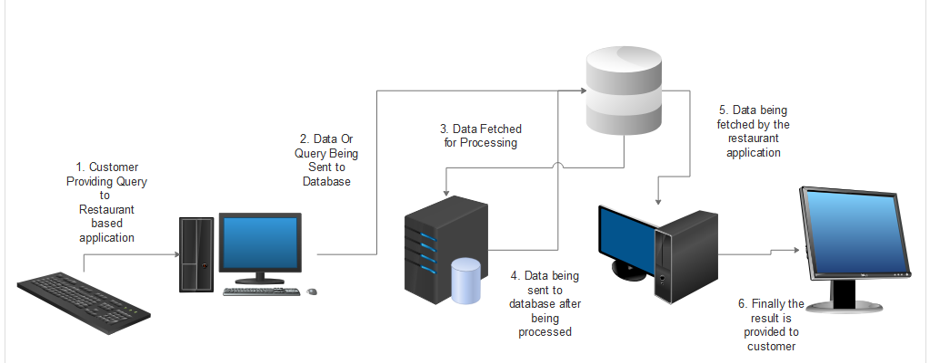
Architecture Diagram & Architecture System

Slide 10
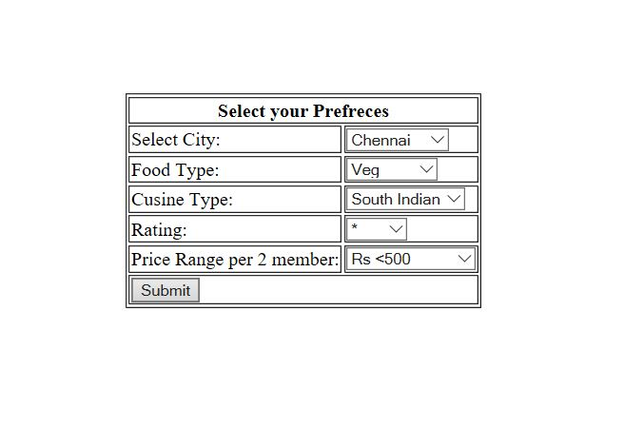
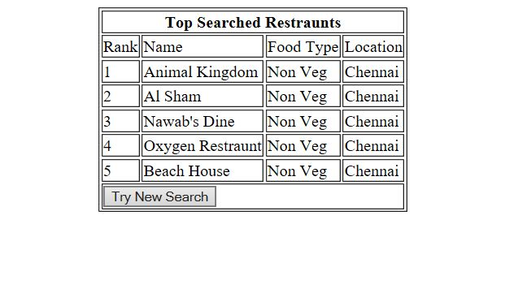
User Interface

Slide 11
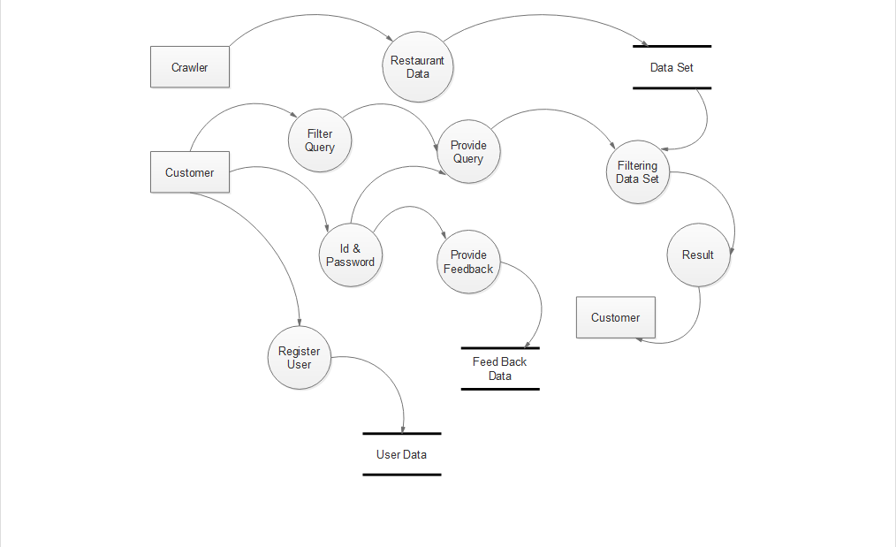
Data Flow Diagram DFD

Slide 12
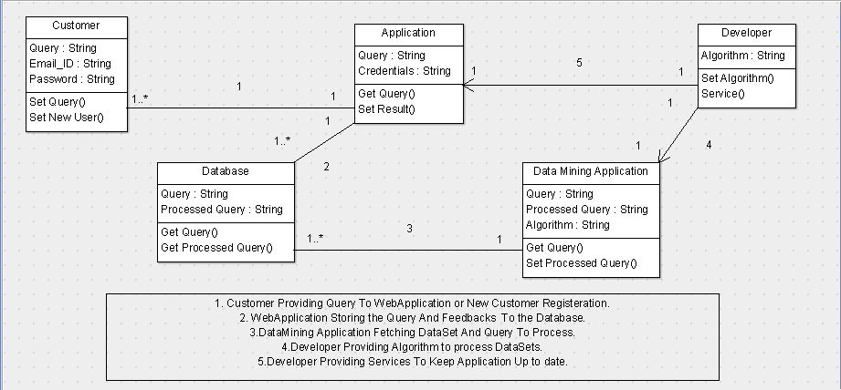
Class Diagram

Slide 13
Sequence Diagram
C:\Users\User\Documents\Major Project.zargo

